Slide 1
Representing Sound
LO: To understand how sound is represented in a computer

Slide 2
Representing Sound
LO: To understand how sound is represented in a computer
Specification Points
3.5.6 Representing images, sound and other data

Slide 3
Representing Sound
LO: To understand how sound is represented in a computer
Analogue and digital signals
Analogue data is data that is infinitely variable and is often represented in the form of a wave.
Digital data is often represented as discrete values shown here with the ons and offs (or zeros and ones) shown as set peaks and troughs.

Slide 4
Representing Sound
LO: To understand how sound is represented in a computer
Analogue to digital conversion
A problem arises when we need to input analogue data into the computer or when we want to output digital data from the computer in analogue form.
In order to do this, an analogue to digital converter (ADC) is needed.
Perhaps the most common converter is the modem which is a device embedded within broadband routers that changes (modulates) a digital signal into analogue so that it can be sent down a telephone wire.
When it is received at the other end, another modem demodulates the signal, converting it back into digital form.
Read this article about how analogue to digital conversion works on the Arduino microcontroller board:
https://learn.sparkfun.com/tutorials/analog-to-digital-conversion

Slide 5
Representing Sound
LO: To understand how sound is represented in a computer
Sound sampling
Sampling is the process of converting analogue sound waves into digital form to create what is commonly known as digitised or digital sound.
An analogue sound wave is infinitely variable so in order to store this digitally, a series of readings at fixed intervals are taken from the wave in order to create the discrete data values that are a defining feature of binary data.

Slide 6
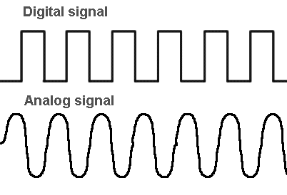
Representing Sound
LO: To understand how sound is represented in a computer
Sound sampling
Using a sensor of some sort e.g. a microphone
Transducers convert physical senses such as brightness or pressure into an electrical signal
The electronic analogue signal is converted to digital using an Analogue to Digital Converter (ADC)
ADC

Slide 7
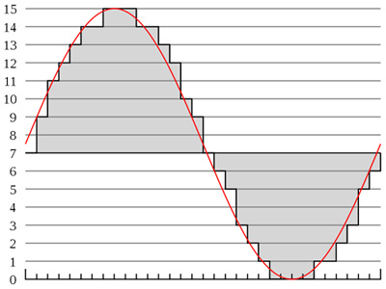
Representing Sound
LO: To understand how sound is represented in a computer
Sound sampling
Samples of the analogue signal are taken at certain time intervals
The more samples taken the greater accuracy of the digital representation of the sound wave
The number of samples taken per second (frequency) = sample rate
The time between each sample = sample interval

Slide 8
Representing Sound
LO: To understand how sound is represented in a computer
Sound sampling
The measurement of the sound wave taken at each interval must be stored digitally using binary.
The more bits used to store the measurement or Sample, the greater the detail it is stored to…
more detail = better quality
e.g. sample 3 in this
example is 9 which is
represent in binary as
follows:
1 0 0 1

Slide 9
Representing Sound
LO: To understand how sound is represented in a computer
Sound sampling
Sample | Value | Binary
1 | 7 | 0111
2 | 9 | 1001
3 | 11 | 1011
4 | 12 | 1100
5 | 13 | 1101
6 | 14 | 1110
7 | 14 | 1110
…

Slide 10
Representing Sound
LO: To understand how sound is represented in a computer
Tasks
In your exercise books write notes on this topic (using the textbooks if necessary)
Answer the following questions:
What impact does the sample interval have on the quality of the sound stored?
What is meant by Sample resolution?
What drawbacks are there of using a high sample rate and sample resolution when recording digital sound?
What is the process of recreating the sound wave from a digital file called and how does it work? (Draw a diagram of this)

Slide 11
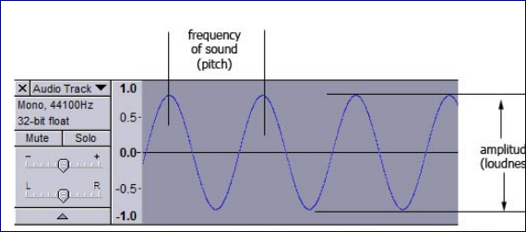
Representing Sound
LO: To understand how sound is represented in a computer
Sampling Frequency
Sampling Frequency: 44,100 HZ (samples per second)

Slide 12
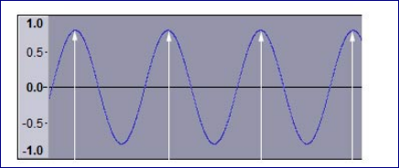
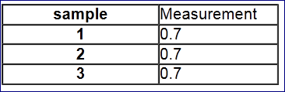
Representing Sound
LO: To understand how sound is represented in a computer
Low Sampling Frequency
What happens if samples are taken too slowly compared to the original sound signal?

Slide 13
Representing Sound
LO: To understand how sound is represented in a computer
Poor Sampling
Sampling Frequency = 1/2 X Wave Frequency

Slide 14
Representing Sound
LO: To understand how sound is represented in a computer
Even Worse Sampling
Sampling Frequency = 1/3 X Wave Frequency

Slide 15
Representing Sound
LO: To understand how sound is represented in a computer
Higher Sampling
Sampling Frequency = 2/3 Wave Frequency

Slide 16
Representing Sound
LO: To understand how sound is represented in a computer
Higher again Sampling
Sampling Frequency = Wave Frequency

Slide 17
Representing Sound
LO: To understand how sound is represented in a computer
Nyquist’s Theorem
The minimum wave frequency should be at least twice the highest frequency in the signal.
E.G. For a CD with sound going up to 20KHz, the minimum sampling rate should be 40KHz.
The music industry usually uses 44.1 KHz
Sampling Frequency = 2 X Wave Frequency

Slide 18
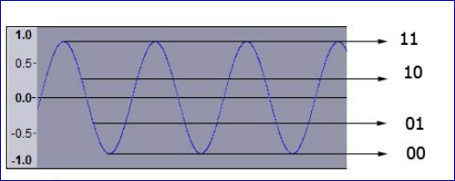
Representing Sound
LO: To understand how sound is represented in a computer
Sampling Depth
The number of bits used to store the samples
This determines the range of samples that can be stored
A 2 bit binary number can only have 4 possible values.
For low quality applications, 8 bit resolution is usually used for sound.
This gives 256 values / levels
Maximum value is 11111111
Minimum value is 0000 0000

Slide 19
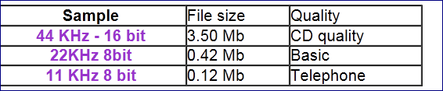
Representing Sound
LO: To understand how sound is represented in a computer
Investigating Sampling Depth
What is the relationship between sampling depth, quality and file size?

Slide 20
Representing Sound
LO: To understand how sound is represented in a computer
Prep:
Streaming Audio
The process of streaming audio over the internet works as follows:
Digital audio file compressed (on the server)
Digital audio file broken down into packets of data
Packets are sent one after another over the Internet
Packets of data are "buffered" so a number of them are downloaded to the user's machine before playback to maintain the illusion of seamless play
Packets of data reassembled and decompressed into a form that can be played by the user's system.
As the buffered packets play, more packets are being downloaded and queued up for playback
Problem
When the stream of packets gets too slow (due to network congestion), the client audio player can ‘run out of’ buffered packets and have nothing to play

Slide 21
Representing Sound
LO: To understand how sound is represented in a computer
Prep:
Read the following article on Windowing. How is this applicable to this topic?
http://searchnetworking.techtarget.com/definition/sliding-windows
Read the following article on analogue to digital conversion:
http://electronics.howstuffworks.com/analog-digital3.htm

Slide 22


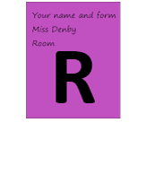


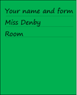
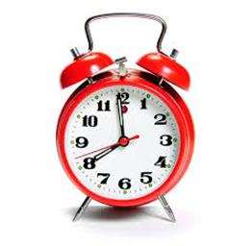
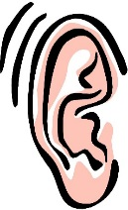




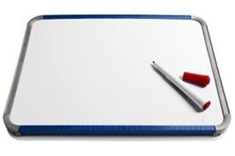


Key words:
Noted clearly
Topic specific vocabulary wherever necessary
Icon for extension activity if appropriate
Icon same colour as dept ex book
You might want to develop subject specific icons

